Slide 1
Corona & Chill
Turn on, tune out, drop off!

Slide 2
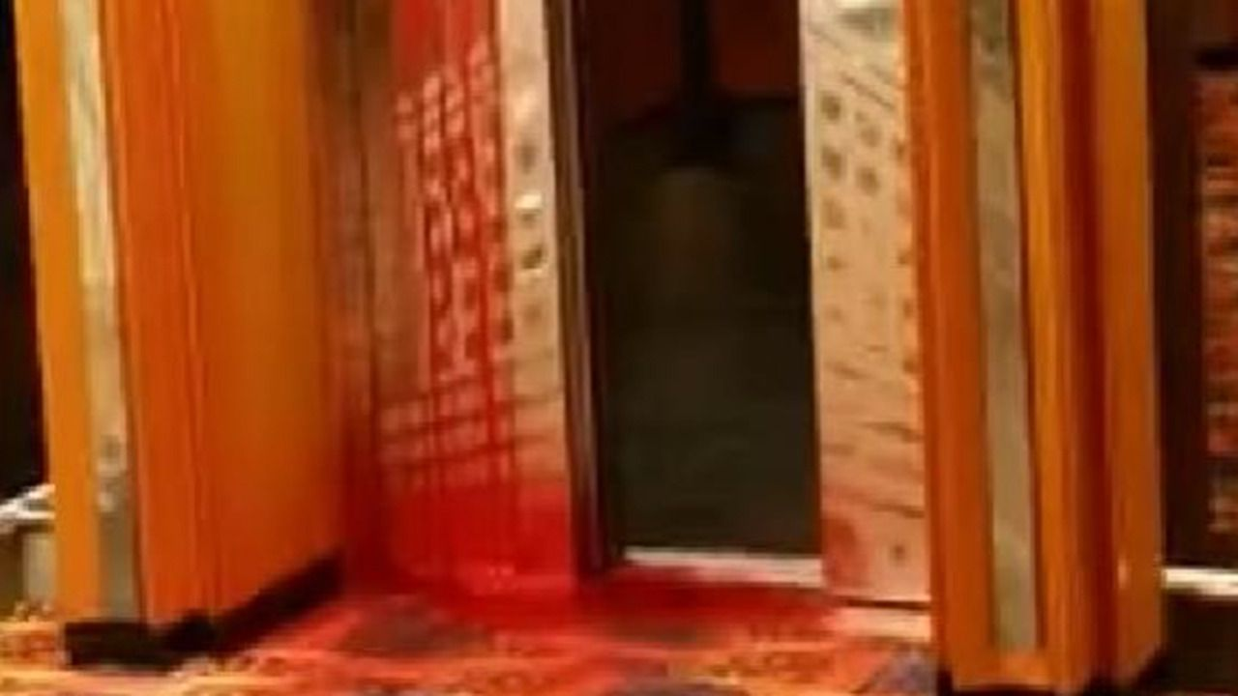


Slide 3
Requirement Checklist [Not exhaustive]
Two server side API’s: IMDB & themovieDB [Ask narwin for latter name]
Non-Bootstrap framework: W3C
Interactive: Input forms [movie search, contact info]
Both API’s new / third party
No alerts, confirms or prompts
Must be deployed to GitHub Pages: See Links slide

Slide 4
User Story
AS A quarantined consumer with a discerning taste in media
I WANT to be able to search for movies to watch
SO that I may binge my way through a potential apocalypse.

Slide 5
DEMO!

Slide 6
Process
And now our group would like to:
  Introduce ourselves
  Explain our role(s), tasks, and technologies we used
  Note any challenges && || successes we had

Slide 7
Future Developments
CS: slideshow
  Incorporate a slider/carousel plugin to more easily add nav arrows, add on click responsiveness, and set animation for slides [ex. having a link to IMDB page of a shown movie or a trailer when slide clicked]
  Fix animation so the array doesn’t just run thru once and sticks, but goes back to start and repeats

Slide 8
Future Developments
CS Misc:
  In the movies page, in addition to narwins movie title input, originally an additional input form would be below that with adjustable parameters [genre, year, actor/actress] that the user could manipulate to show a random array of movie options based on said parameters if they didn’t have an specific movie in mind. This was hindered by the inherent limitations of the API used. Also more info on interfacing a form with AJAX call/response(s) required.

Slide 9
Links
Deployed
  https://cas2931.github.io/bcsProject1/
GitHub Repo
  https://github.com/cas2931/bcsProject1

